Slide 1
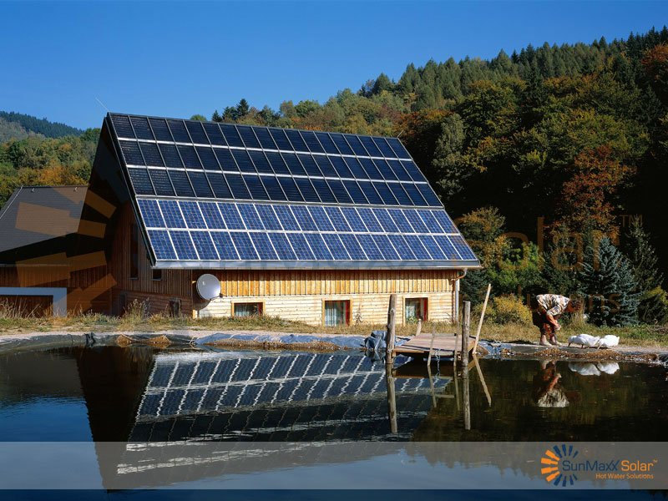
Solar Hot Water
www.sunmaxxsolar.com

Slide 2
Solar Hot Water
Direct versus Indirect
Direct: Potable water heated by sun
Best where freezing not a concern
Indirect: Heat-transfer fluid heated by sun
Passive versus Active
Passive: Circulation driven by convection
Active: Circulation driven by pump (most common)
Antifreeze versus Drainback
Antifreeze: heat-transfer fluid will not freeze
Drainback: water drained from collectors in freezing weather
Notes:
Glycol/water mixtures (www.pasolar.ncat.org) The most common fluid used in closed solar water heating systems is propylene glycol. Glycol/water mixtures have a 50/50 or 60/40 glycol-to-water ratio. Ethylene and propylene glycol are "antifreezes." Ethylene glycol is extremely toxic and should only be used in a double-walled, closed-loop system. You can use food-grade propylene glycol/water mixtures in a single-walled heat exchanger, as long as the mixture has been certified as nontoxic. Make sure that no toxic dyes or inhibitors have been added to it. Most glycols deteriorate at very high temperatures. The pH value, freezing point, and concentration of inhibitors should be checked annually to determine whether the mixture needs any adjustments or replacements to maintain its stability and effectiveness.

Slide 3
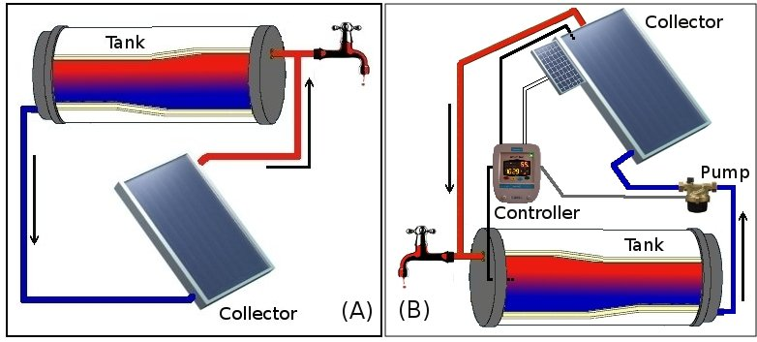
Direct
Passive
Active
upload.wikimedia.org

Slide 4
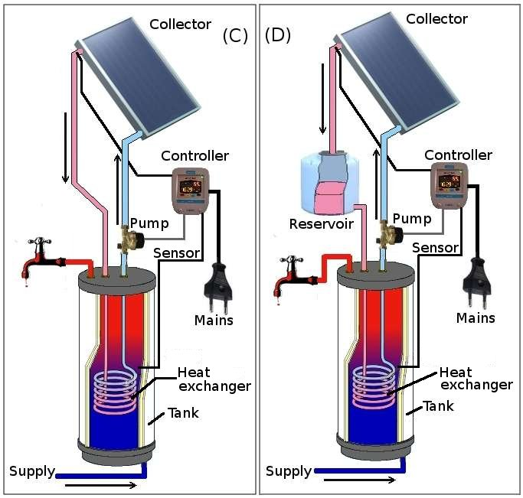
Indirect
upload.wikimedia.org
Antifreeze
Drainback
Notes:
Components: Expansion Tank (www.pasolar.ncat.org)
An expansion tank allows the fluid in a closed-loop system to expand and contract depending on the temperature of the fluid. Without the expansion tank, the plumbing would easily burst when the fluid is heated. Diaphragm-type expansion tanks are constructed with an internal bladder and a pressurized air chamber. Heated fluid expands in the closed loop against the bladder and pressurized air chamber. As the fluid contracts while cooling, the air chamber maintains pressure in the closed loop. The size of the expansion tank must be able to handle the expansion based on the volume, coefficient of expansion, and range of temperature fluctuation. The size and number of collectors, and the size and length of piping and fittings determine fluid volume. Diaphragm-type expansion tanks are readily found in most plumbing supply houses.

Slide 5
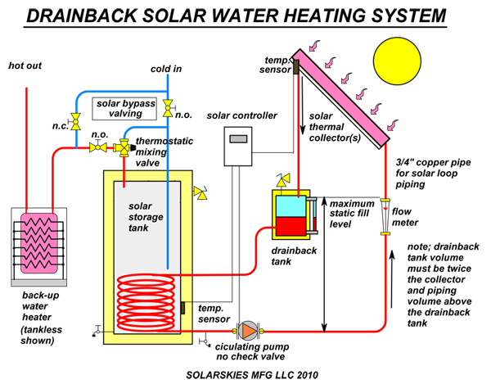
Drainback
www.solarskies.com

Slide 6
Solar Hot Water
Home Hot Water
Home Heating with Water
Central Hot Water System
All systems need
Collectors
Storage
Distribution

Slide 7
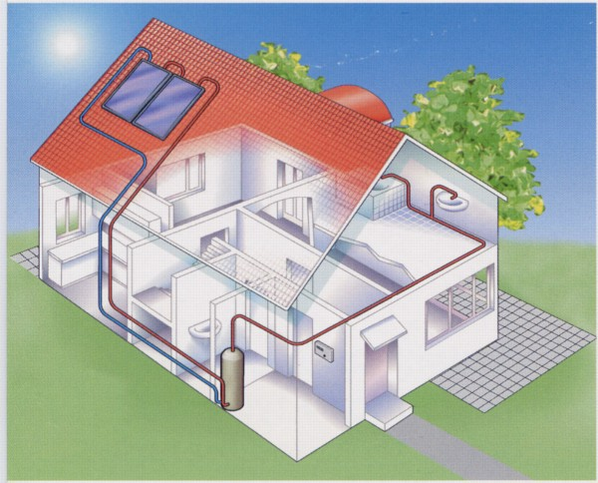
Home Hot Water

Slide 8
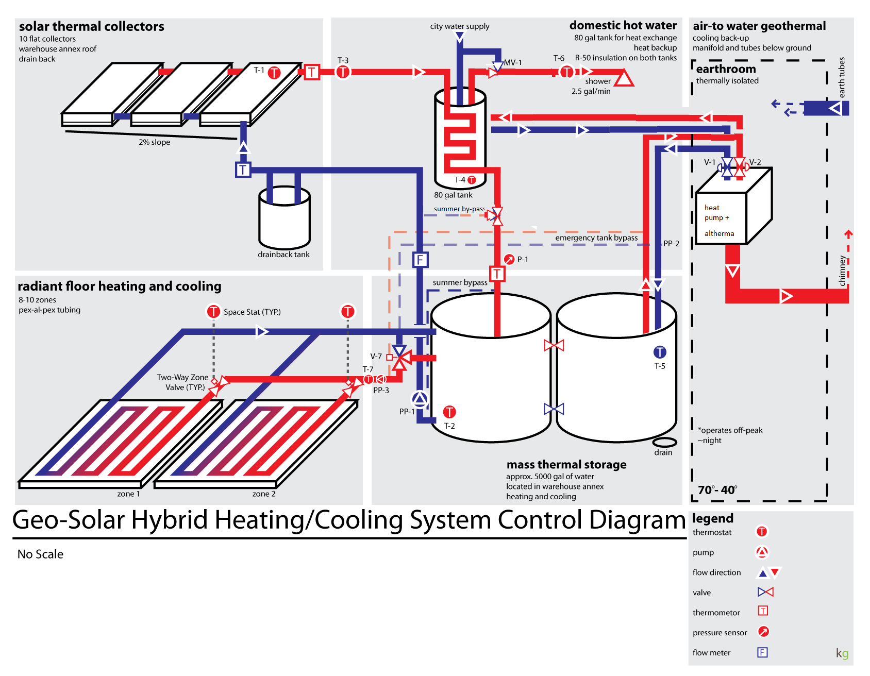
Heating with Water (& Cooling)
greengaragedetroit.com
Notes:
Heat pump used to supplement heating OR cooling water

Slide 9
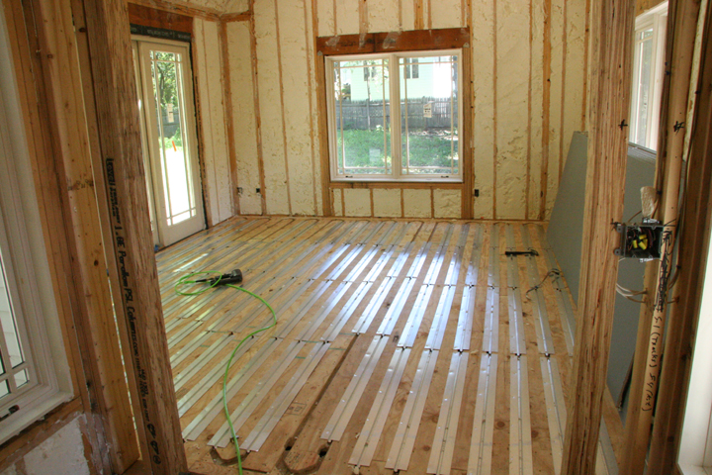
Radiant Flooring
cleanenergydesign.com

Slide 10
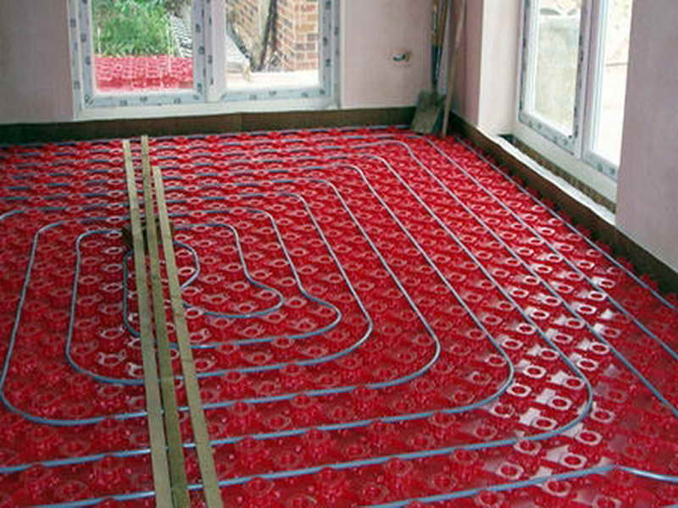
Radiant Flooring
bloombety.com

Slide 11
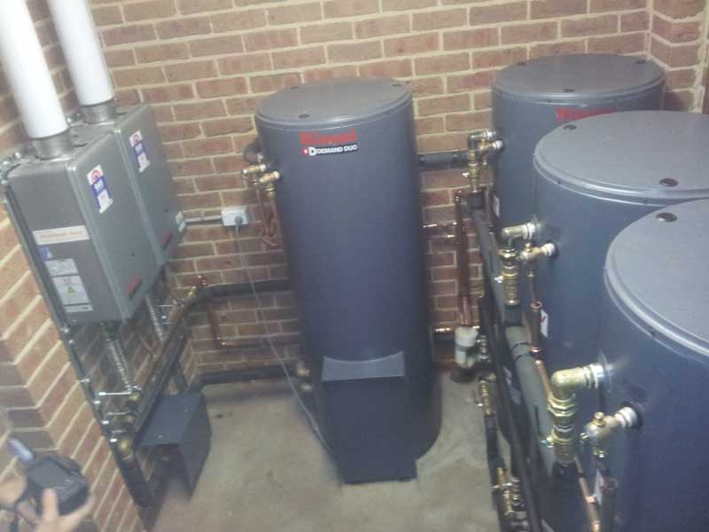
www.superiorsolar.com.au

Slide 12
Central Hot Water System
Serve clusters of buildings from a large centralized solar thermal field(s)
Energy Independence & Security Act of 2007
“if lifecycle cost-effective, as compared to other reasonably available technologies, not less than 30% of the hot water demand for each new Federal building or Federal building undergoing a major renovation be met through the installation and use of solar hot water heaters.”
Central Solar Hot Water System Design Guide, US ACE, 2011
Notes:
Solar District Heating

Slide 13
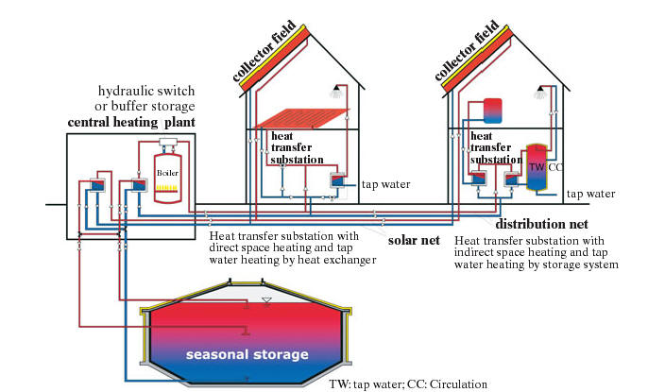
www.tzs.uni-stuttgart.de
Notes:
Solar assisted district heating systems with short-term heat stroage are designed for a solar fraction, based on the total heat demand for space heating and hot water preparation, of approx. 15 to 20 %. Usage of solar heat in solar assisted district heating systems enables to install large collector fields which are in comparison to small collector systems much cheaper. Solar fraction is the proportion of usable solar heat in the total energy used (hot water and space heating).
Solar assisted district heating systems with long-term heat stroage are designed for a solar fraction, based on the total heat demand for space heating and hot water preparation, of approx. 50 %. Those systems usually have more than 100 flats. The seasonal difference between high solar irradiance in summer and high heat demand in winter is balanced by seasonal heat storage. Figure 1 shows a scheme of different possibilities to integrate the district heating net into the buildings.
Table 1: design guidelines for solar assisted district heating systems (FC: flat plate collector; w: water equivalent; *basis: TRNSYS-calculations for long-term operation
System typeSmall solar system for domestic hot water (for comparison)Central solar heating plant with diurnal storage (CSHPDS)Central solar heating plant with seasonal storage (CSHPSS)Minimum system size-More than 30 apartments or more than 60 personsMore than 100 apartments (each 70 m²)Collector area1–1.5 m²_{FC} per person0.8–1.2 m²_{FC} per person1.4–2.4 m²_{FC} per MWh annual heat demandStorage volume50–80 litres/m²_{FC}50–100 litres/m²_{FC}1.4–2.1 m³_{W}/m²_{FC}Solar net energy350–380 kWh/m²_{FC} per annum350–500 kWh/m²_{FC} per annum230–350 kWh/m²_{FC} per annumSolar fraction (new building code)Domestic hot water50 %50 %Total heat demand15 %10-20 %40-60 %Solar heat cost in GermanyEuro 0.15–0.3/kWhEuro 0.08–0.15/kWhEuro 0.16–0.42/kWh

Slide 14
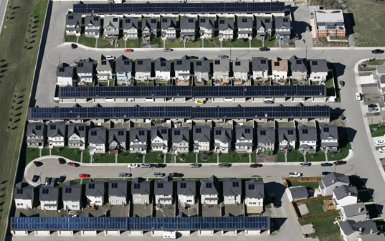
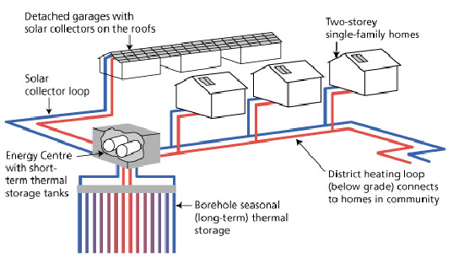
Drake Landing Solar Community
Canada
www.inhabitat.com
Notes:
The Drake Landing Solar Community is the first solar powered community of North America. Located in the town of Okotoks, Alberta, Canada, the project sets a wonderful example of how every household can lead a sustainable lifestyle. There are 800 solar panels located throughout the community on garage roofs, and they produce 1.5 mega-watts of thermal power during a summer day and supply heat to the district heating system. The whole system meets 90% of the annual heating and hot water needs of the homes. Read more: A Unique Solar Powered Community in Canada | Inhabitat - Sustainable Design Innovation, Eco Architecture, Green Building

Slide 15
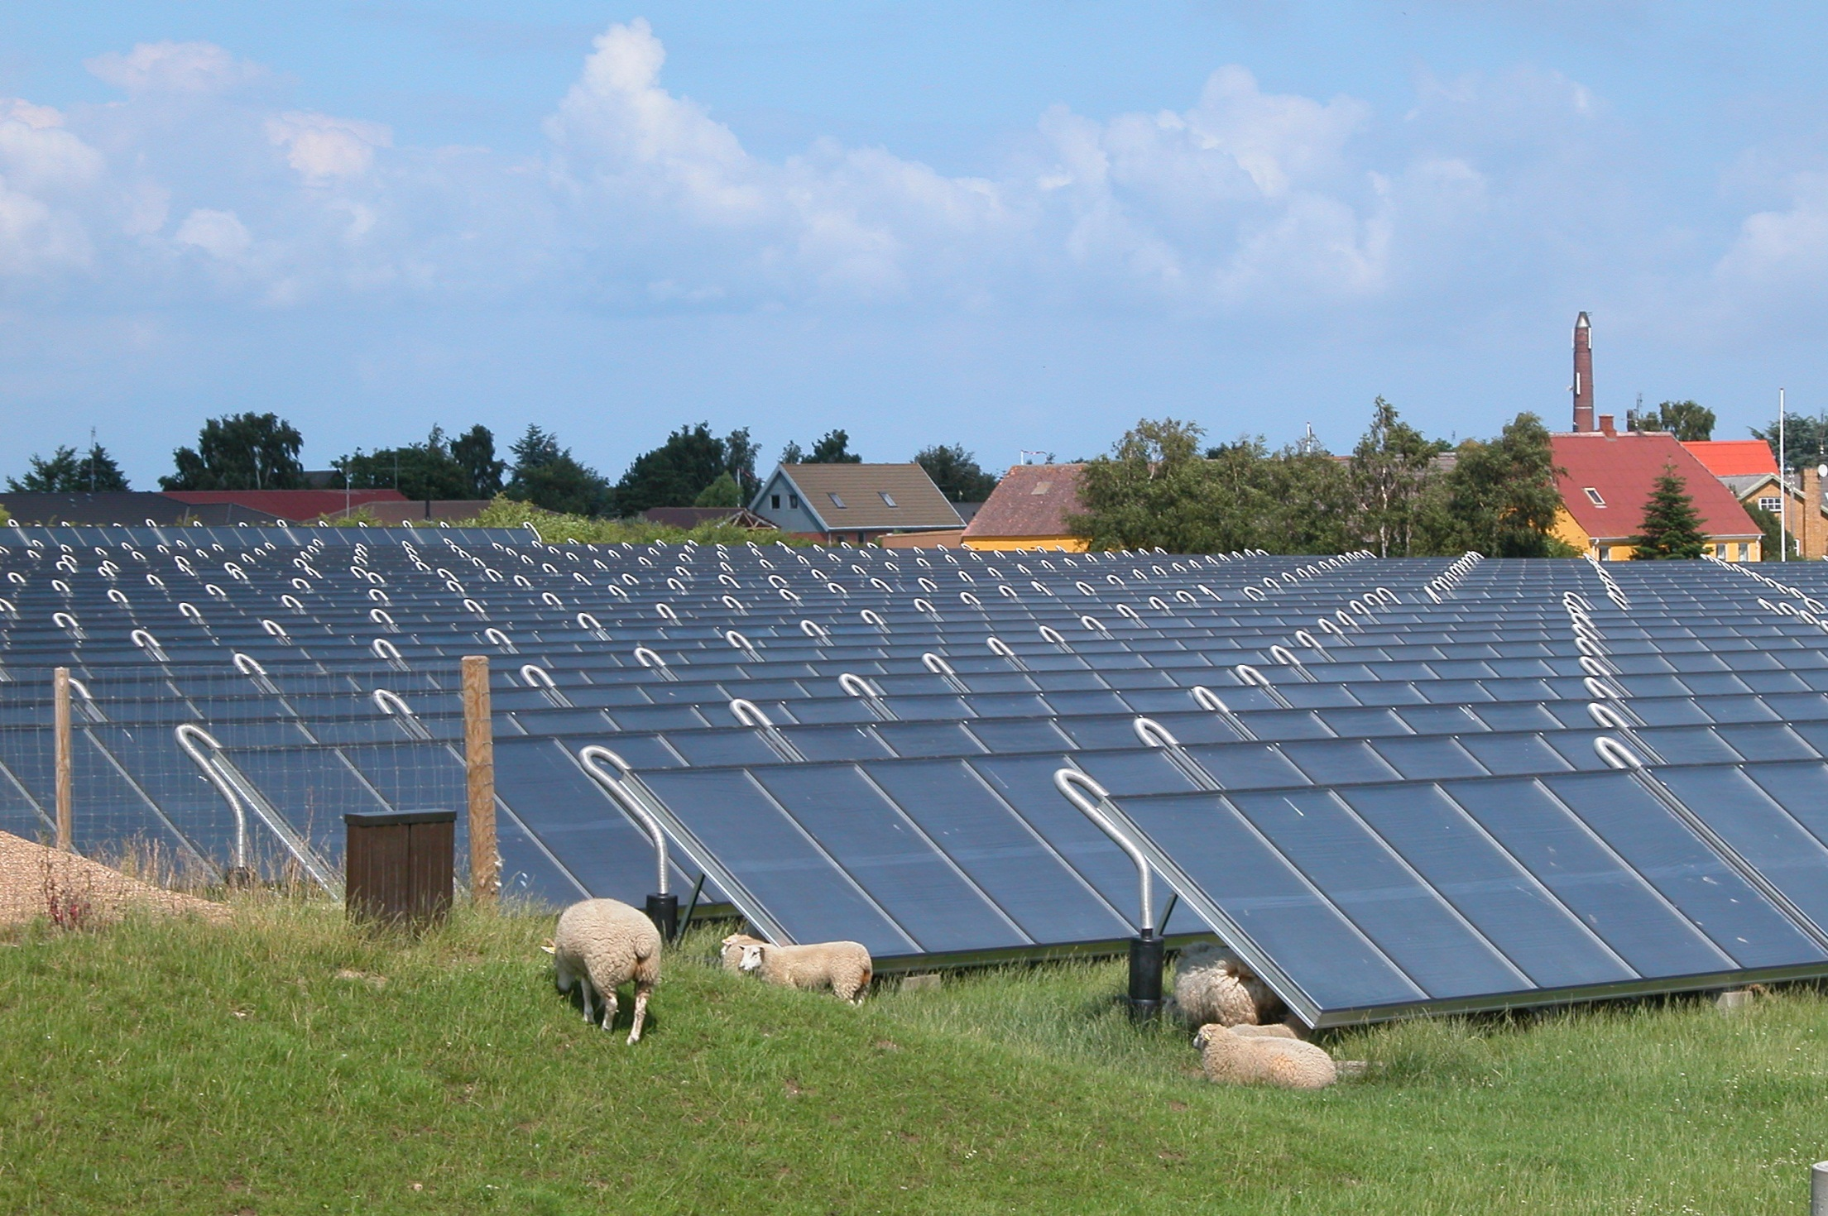
Marstal, Denmark
Solar Collectors with Heat Storage
Started 1996
Search “Reberbanen, Marstal, Denmark” in Google Maps

Slide 16
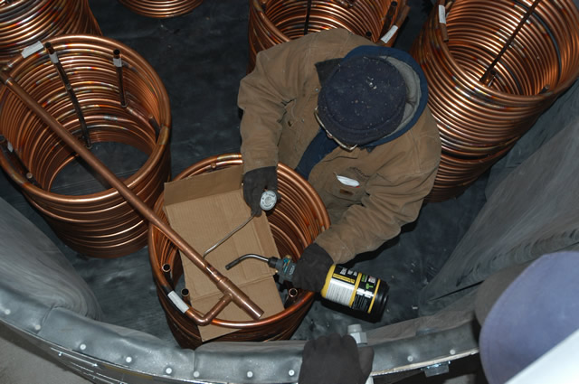
Storage and Thermal Transfer
prudentliving.com

Slide 17
Collectors
Flat plate
Tube between glazing & absorber plate
Water temperature up to 170 to 180 F
Evacuated tube
Heat pipe surrounded by vacuum for insulation
Inner tube contains liquid that boils at low temperature
Hot gas rises to heat exchanger at top
Temperature as high as 250 F
Notes:
http://www.solarpanelsplus.com/
Flat Plate Collectors
Flat plate collectors have been on the market and in use since the early 1900's, and are one of the most time tested and well known technologies. They consists of an absorber plate – generally a painted metal, such as copper – attached to copper pipes where water or a heat transfer liquid passes through. This is encased in a metal frame, surrounded by thick insulation to help retain the collected heat, and protected by a sheet of glass or glazing, which also provides an insulating air space.
Evacuated Tube Collectors
Evacuated tube collectors are a slightly more recently developed technology, introduced to the market in the 1970's. There are several varieties of evacuated tubes, however the most commonly used type employs the use of a heat pipe surrounded by a glass tube that is under a vacuum. The glass tube actually consists of two walls of glass. In between the two walls, all the air is removed, resulting in a vacuum. This vacuum is the best insulation one could ask for, and gives the evacuated tubes a much better heat retention than air space.
The heat pipe is also pressurized, allowing the liquid (usually water) to boil very rapidly, at a very low temperature (usually between 75F and 80F). As the water boils, it carries the collected heat to the top of the collector, where the heat is then collected by water or heat transfer liquid that flows around the top of the heat pipe, and then transferred to a storage tank or elsewhere in the system.

Slide 18
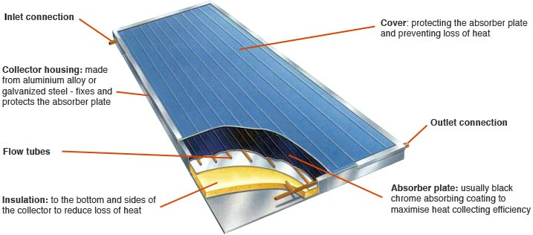
Flat Plate Schematic

Slide 19
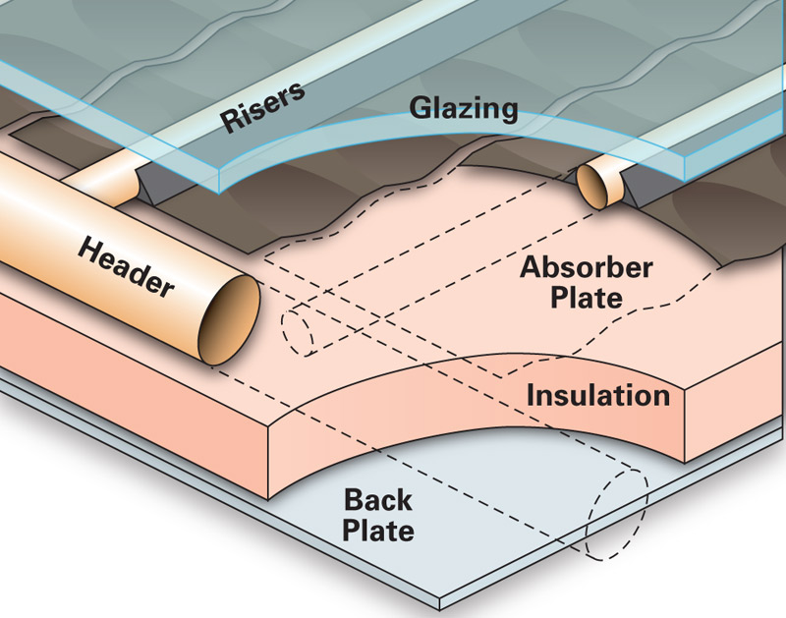
Close Up
www.homepower.com

Slide 20
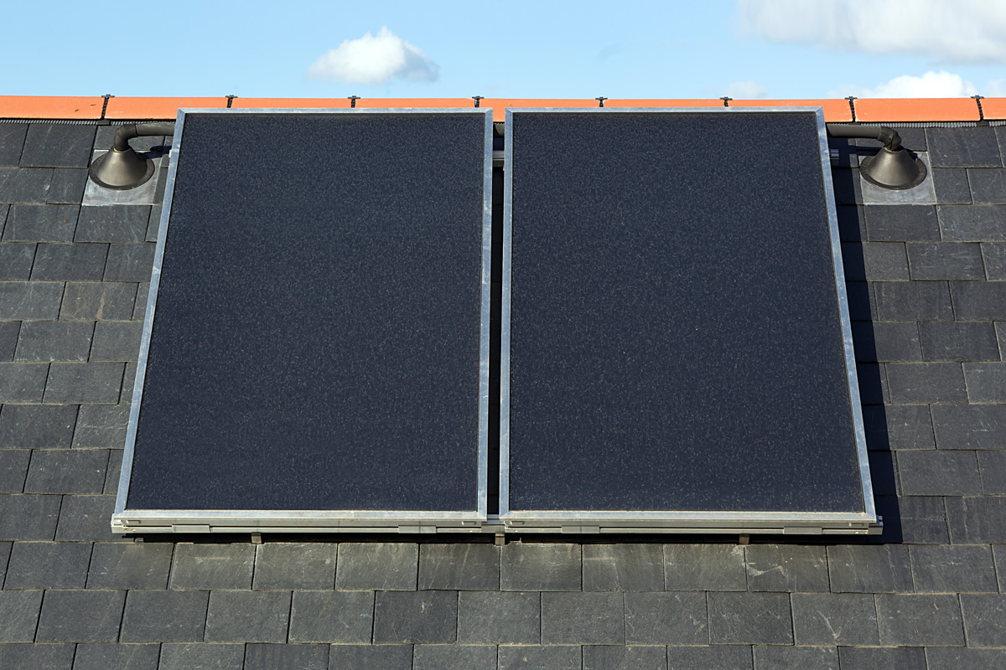
Installed
www.greenoorjasolutions.com

Slide 21
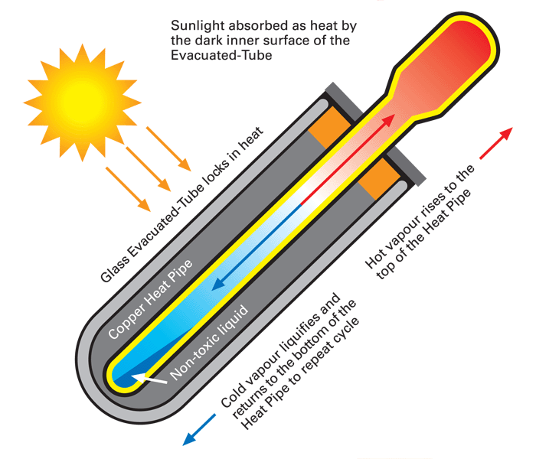
Evacuated Tube
cdn.siliconsolar.com

Slide 22
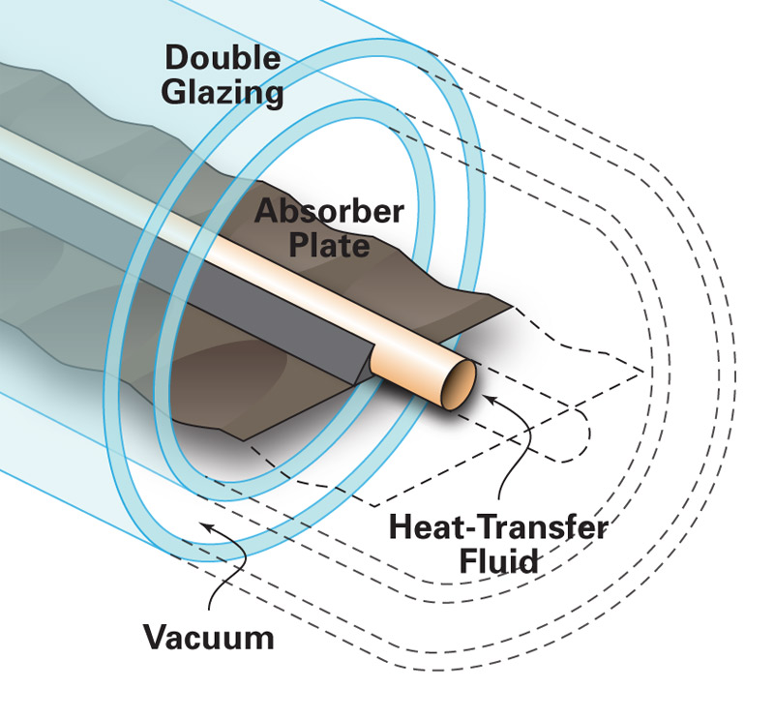
Close Up
www.homepower.com

Slide 23
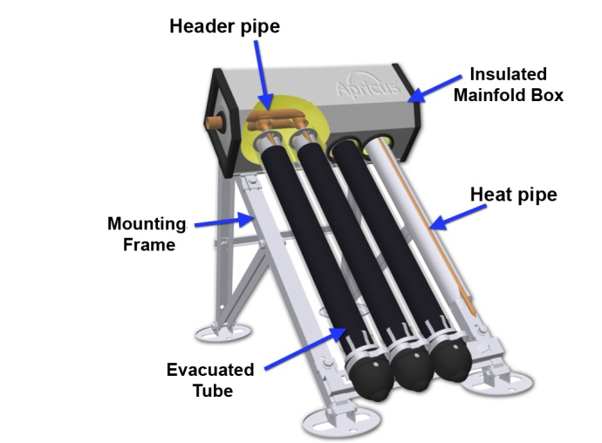
Ground or Flat Roof Mount
http://www.intechopen.com/

Slide 24
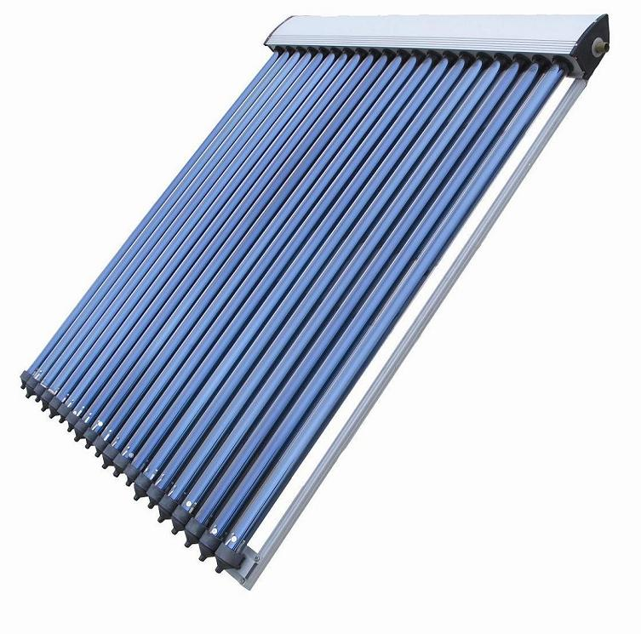
Evacuated Tube
http://www.clearchain.com/

Slide 25
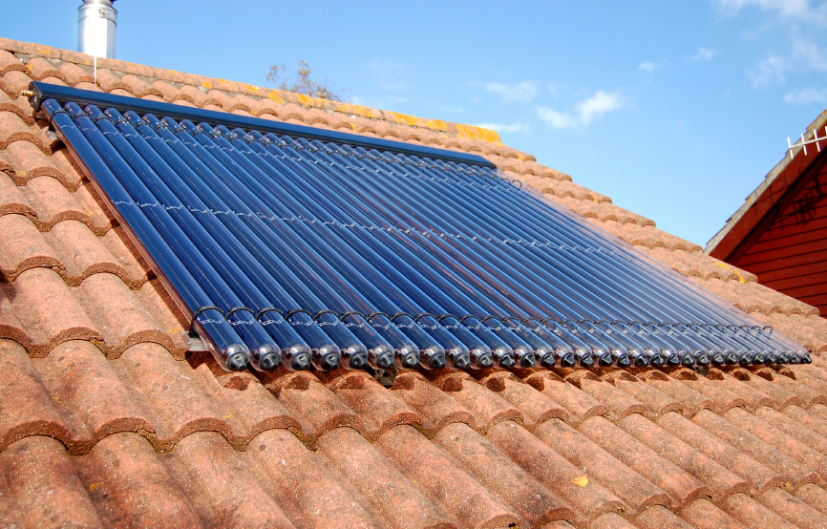
Installed
www.yougen.co.uk

Slide 26
Flat Plate (FP) Versus Evacuated Tube (ET)
Efficiency
ET: more efficient (more kW/m²)
especially in colder climates (vacuum insulation)
FP: leaks some heat, which helps melt snow
Cost
ET: 10 - 15% more expense on kW basis
FP: fluctuates with copper price
Installation
ET: can be assembled in place, but takes time
FP: come assembled & install fast, but are heavy
FP more sensitive to sun angle, may need special racking
Maintenance
EV: If vacuum lost, must replace
EV: more likely to over heat
Side-by-side installation
Notes:
www.solarpanelsplus.com
blog.heatspring.com

Slide 27
Rules of Thumb
North Carolina Solar Center (2002) Passive and Active Solar Domestic Hot Water Systems, Raleigh, NC
10 – 18 ft² collector / person
1.5 – 2.0 gallons storage / ft² collector
Collectors ~ 4’ x 8’ = 32 ft²
Family of four needs 1 – 3 units
www.pasolar.ncat.org, Solar Water-Heating Systems: Siting and Sizing, accessed 2014
Collectors: 20 ft² for first person
Northern US: 12 – 14 ft² for each additional person
Sunbelt: 8 ft² for each additional person
Storage
Northern: 1.5 gallons per ft² collector
Southern: 2.0 gallons per ft² collector

Slide 28
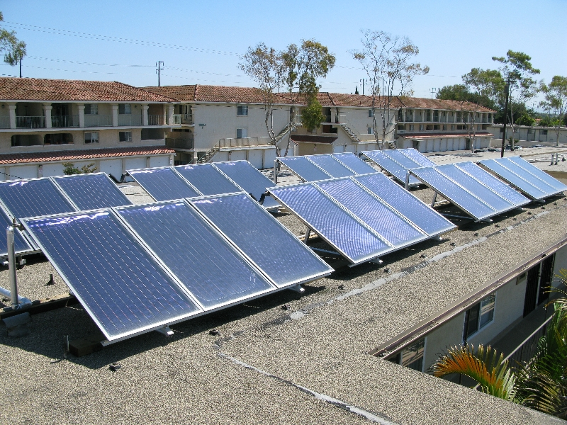
www.freehotwater.com

